Slide 1

Hotel Reservation
Analysis with SQL
Patel Darshan jitendraKumar
Batch – MIP-DA-10

Slide 2
Overview:
The hotel industry relies on data to make informed decisions
and provide a better guest experience. In this internship,
internship, you will work with a hotel reservation dataset
to gain insights into guest preferences, booking trends, and
other key factors that impact the hotel's operations. You will
use SQL to query and analyze the data, as well as answer
specific questions about the dataset.

Slide 3
Dataset Details:
1. Booking_ID: A unique identifier for each hotel reservation.
2. no_of_adults: The number of adults in the reservation.
3. no_of_children: The number of children in the reservation.
4. no_of_weekend_nights: The number of nights in the reservation that fall on
weekends.
5. no_of_week_nights: The number of nights in the reservation that fall on
weekdays.
6. type_of_meal_plan: The meal plan chosen by the guests.
7. room_type_reserved: The type of room reserved by the guests.
8. lead_time: The number of days between booking and arrival.
arrival_date: The date of arrival.
9. market_segment_type: The market segment to which the reservation
belongs.
10. avg_price_per_room: The average price per room in the reservation.
booking_status: The status of the booking.

Slide 4

1. What is the total number of reservations in the dataset?
select count(*) from hotel;

Slide 5
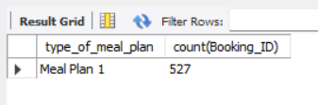
2. Which meal plan is the most popular among guests?
select type_of_meal_plan,count(Booking_ID)
from hotel
group by type_of_meal_plan limit 1;

Slide 6

3. What is the average price per room for reservations involving children?
select type_of_meal_plan,count(Booking_ID)
from hotel
group by type_of_meal_plan limit 1;

Slide 7

4. How many reservations were made for the year 20XX (replace XX with the desired year)?
select year(str_to_date(arrival_date, "%d-%m-%y"))as Year,
count(*) as Total from hotel group by year;

Slide 8
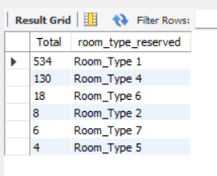
5. What is the most commonly booked room type?
select count(room_type_reserved) AS Total ,room_type_reserved
from hotel group by room_type_reserved order by Total desc;

Slide 9

6. How many reservations fall on a weekend (no_of_weekend_nights > 0)?
select count(no_of_weekend_nights) AS weekend_reservations
from hotel where no_of_weekend_nights > 0;

Slide 10

7. What is the highest and lowest lead time for reservations?
select max(lead_time) AS highest, min(lead_time) AS Lowest from hotel;

Slide 11
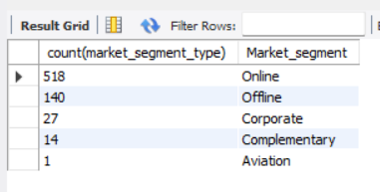
8. What is the most common market segment type for reservations?
select count(market_segment_type),market_segment_type AS Market_segment
from hotel group by market_segment_type
order by Market_segment desc;

Slide 12
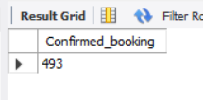
9. How many reservations have a booking status of "Confirmed"?
select count(booking_status) AS Confirmed_booking
from hotel where booking_status = 'Not_Canceled';

Slide 13
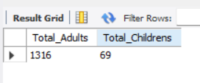
10. What is the total number of adults and children across all reservations?
select sum(no_of_adults) AS Total_Adults, sum(no_of_children)
AS Total_Childrens from hotel;

Slide 14
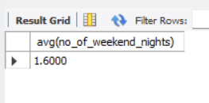
11. What is the average number of weekend nights for reservations involving children?
select avg(no_of_weekend_nights) from hotel
where no_of_weekend_nights > 0 and no_of_children > 0;

Slide 15
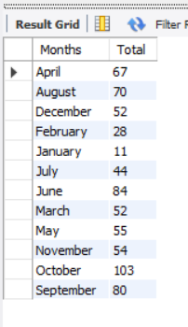
12. How many reservations were made in each month of the year?
select monthname(str_to_date(arrival_date, "%d-%m-%y")) as Months,
count(*) as Total from hotel group by Months;

Slide 16
13. What is the average number of nights (both weekend and weekday) spent by guests for each room
type?
select monthname(str_to_date(arrival_date, "%d-%m-%y")) as Months,
count(*) as Total from hotel group by Months;

Slide 17
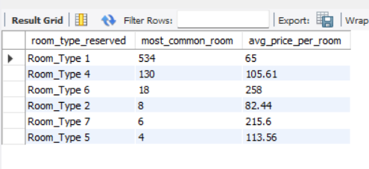
14. For reservations involving children, what is the most common room type, and what is the average
price for that room type?
select room_type_reserved,count(no_of_children) AS most_common_room,avg_price_per_room
from hotel group by room_type_reserved
order by most_common_room desc;

Slide 18
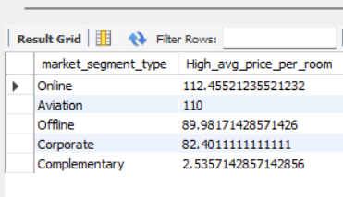
15. Find the market segment type that generates the highest average price per room.
select market_segment_type,avg(avg_price_per_room) AS High_avg_price_per_room from hotel
group by market_segment_type
order by High_avg_price_per_room desc;

Slide 19
Conclusion
-> Most popular meal plan: Meal Plan 1 (527 reservations)
-> Most booked room type: Room Type 1 (534 reservations)
-> Weekends account for 383 reservations
-> Online market segment dominates with highest average room price ($58,251)
-> High booking confirmation rate: 493 reservations confirmed

Slide 20
Thanks For Watching

